Slide 1
Data Augmentation from ETF
AI part
Kim Young Oh, Kim Min Jae

Slide 2
[Ongoing]
Image making from Time-Series data for CNN input
[To Do]
Searching packages for LSTM-CNN Fusion before FNN

Slide 3
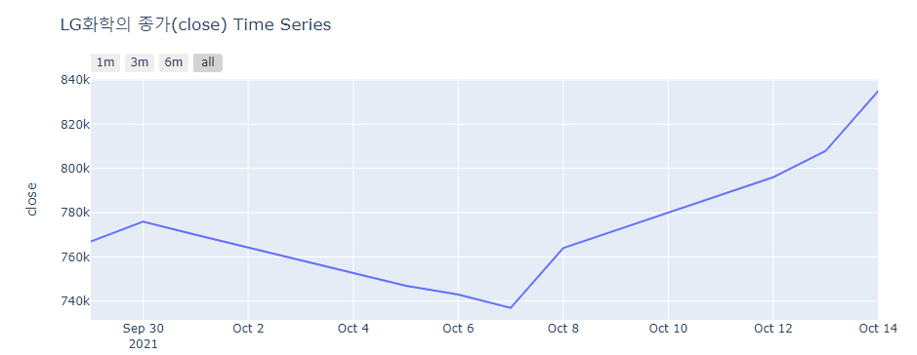
Input Data augmentation
[Data to Graph]
①. First Try - LG화학
matplotlib
Day-by-Day
input: date, close

Slide 4
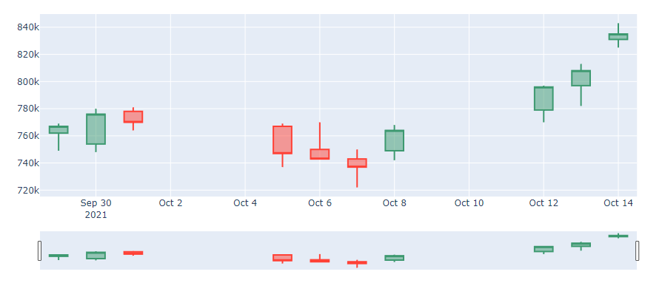
Input Data augmentation
[Data to Graph]
②. Second Try - LG화학
plotly
Day-by-Day
Candle Stick, input: date, open, high, low, close

Slide 5
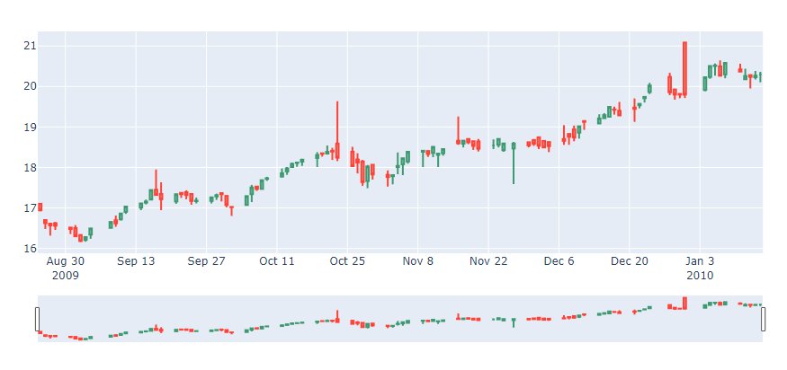
Input Data augmentation
[Data to Graph]
③. Third Try - amj.us from Kaggle
plotly
Day-by-Day
Candle Stick, input: date, open, high, low, close

Slide 6
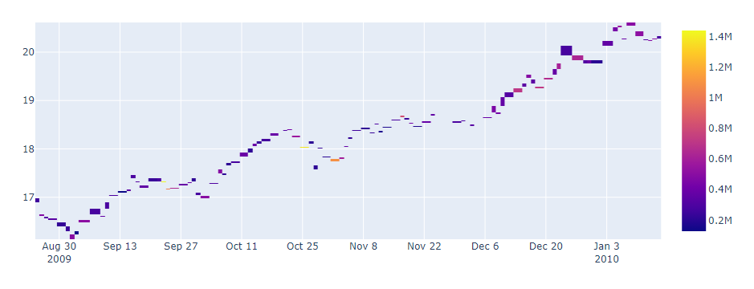
Input Data augmentation
[Data to Graph]
④. Other Try - add ‘Volume’ factor
plotly
Day-by-Day
Heatmap, Input: date, volume, close

Slide 7
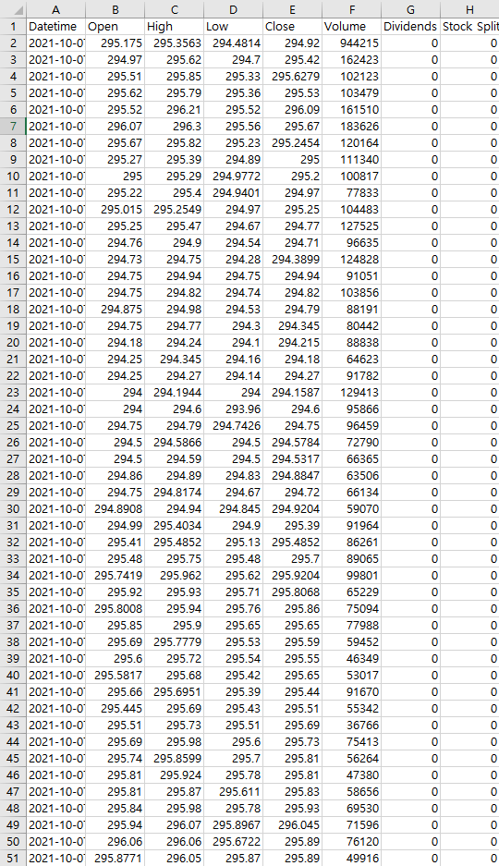
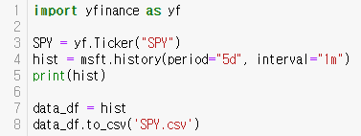
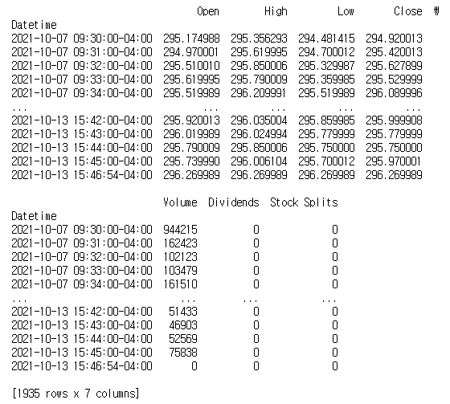
Input Data augmentation
[Stock Data Info.]
by Yahoo Finance, yfinance
S&P 500 SPY Ticker
Minute-by-Minute
▲python code
▲print result in python
save to csv(excel file)▶

Slide 8
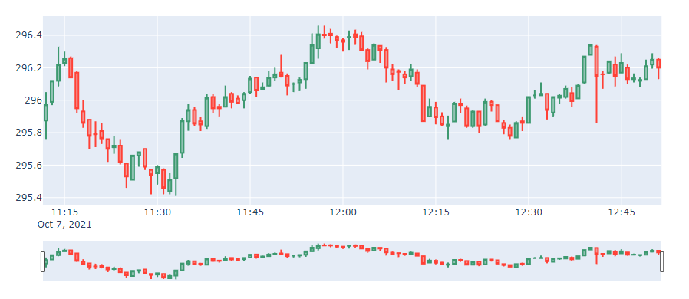
Input Data augmentation
[Data to Graph]
⑤. Fifth Try - S&P 500 SPY
plotly
Minute-by-Minute
Candle Stick, input: date, open, high, low, close

Slide 9
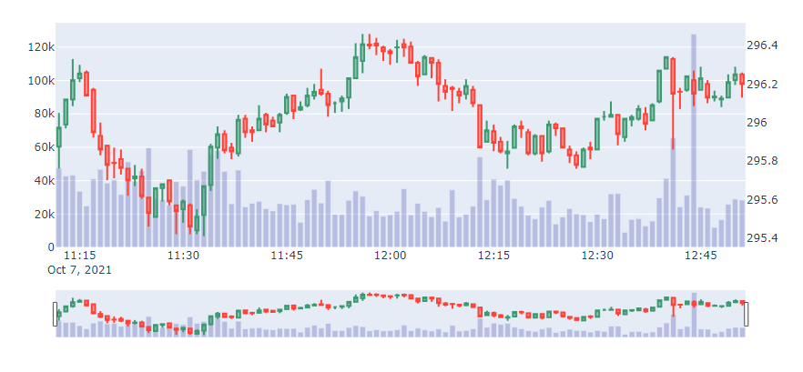
Input Data augmentation
⑥. Fifth Try - S&P 500 SPY + Volume Bar
plotly
Minute-by-Minute
Candle Stick, input: date, open, high, low, close
volume bar, input: date, Volume
[Data to Graph]
overlay two chart

Slide 10
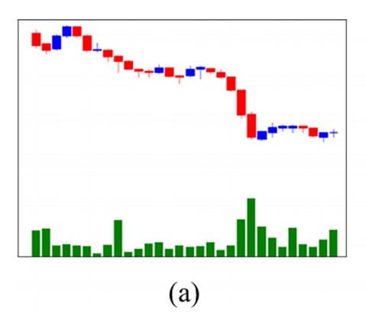
Input Data augmentation
[Compare Graph]
▲Graph at previous model
▲Graph we implement

Slide 11
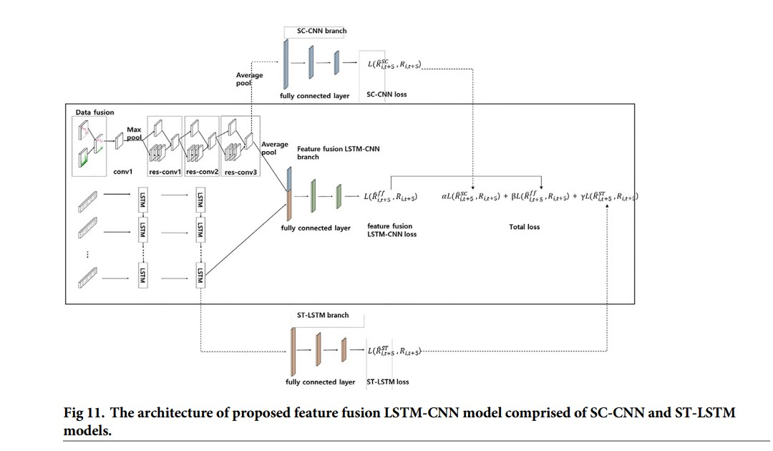
LSTM-CNN Fusion
[To Do] Finding the method for junction between CNN & LSTM
How to implement junction between CNN & LSTM?
CNN
LSTM

Slide 12
References
1. Kim T, Kim HY (2019) Forecasting stock prices with a feature fusion LSTM-CNN model using different representations of the same data. PLoS ONE 14(2): e0212320. https://doi.org/
10.1371/journal.pone.0212320
2.https://plotly.com/python/

